Slide 1
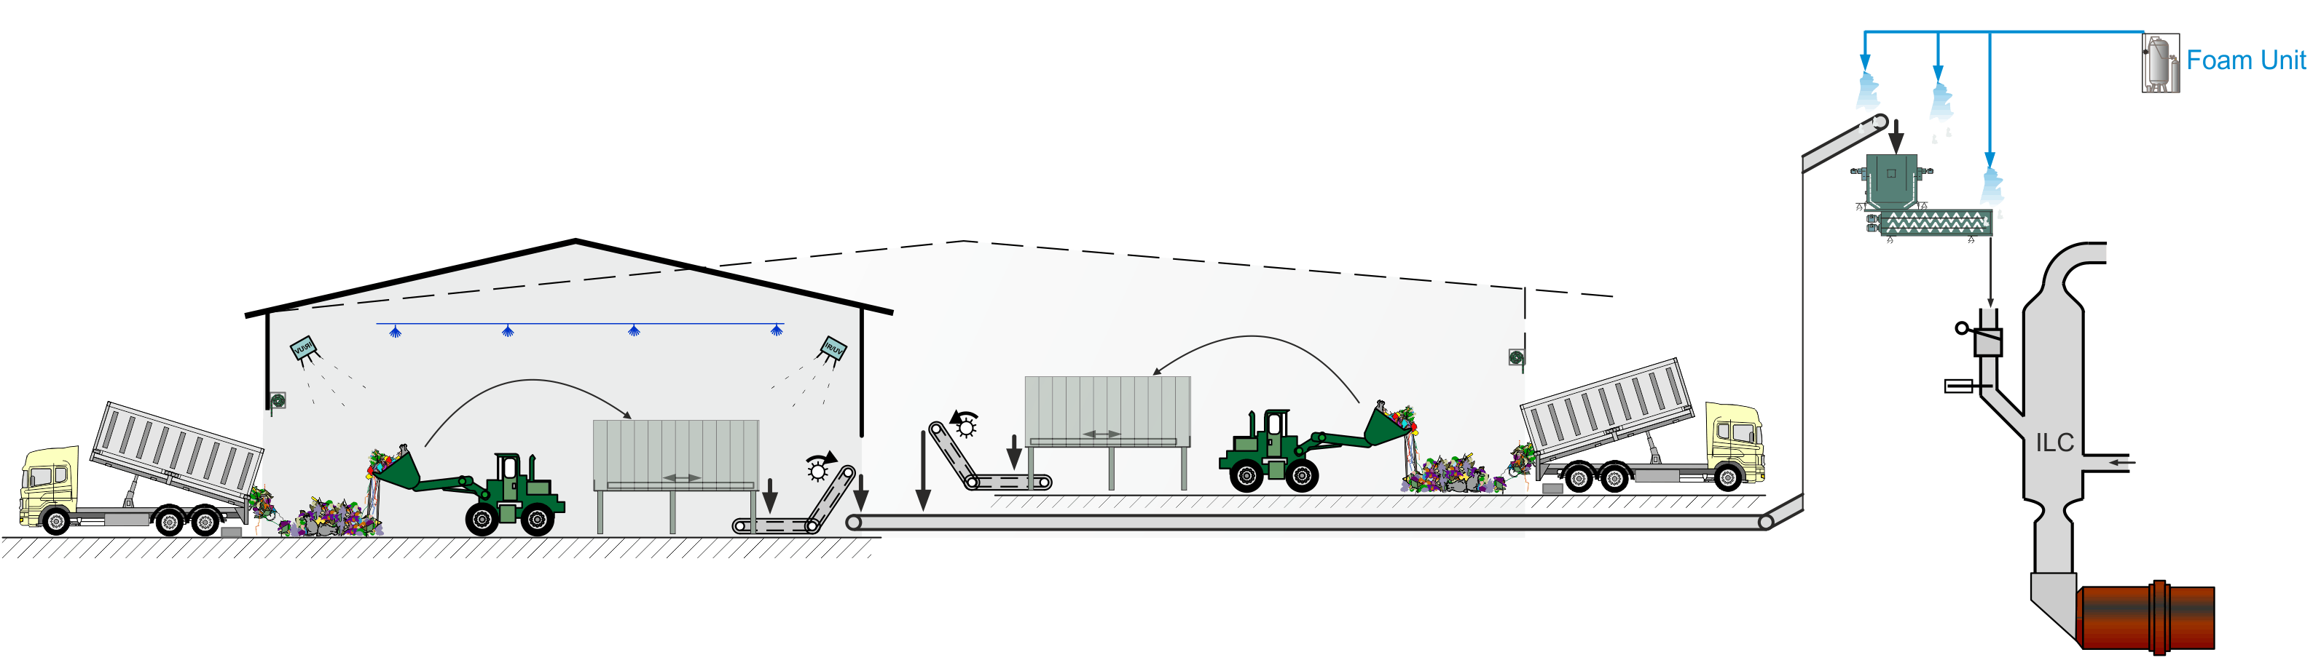
AF Feeding Case Study
SPREAD Course 2016, Settat, Sorin Petrescu - Geocycle

Slide 2
Case Study Procedure
Divide in 2 Groups, work in pairs of two people
Group1 works on Case1
Group2 works on Case2
If you are finished with your Case, you can start on the other.
Case1:
Shredded solids feed system to precalciner
Push-floor hopper, belt (VSD) with stripping wheel and weighing idler, bucket elevator, conveyor belts.
Case2:
Tyre chip feed system to precalciner
Apron extractor/feeder (VSD) with stripping wheel (calibrator), belt weigh feeder (VSD), conveyor belts.

Slide 3
Objectives / Tasks
Evaluate the feed system performance
Check and assess your dataset
Copy-paste the data into your tool. Complete the necessary inputs (SP)
Use the Dosing Accuracy & Stability Tool
only assess Stability (no information is given to evaluate accuracy e.g. weigh-outs)
Judge the results
Average vs. Set-point
Standard Deviation and Coefficient of Variation (CoV)
Give examples from your concrete cases
Give general feedback and recommendations
Final thoughts and messages
Available time: 45 min.

Slide 4
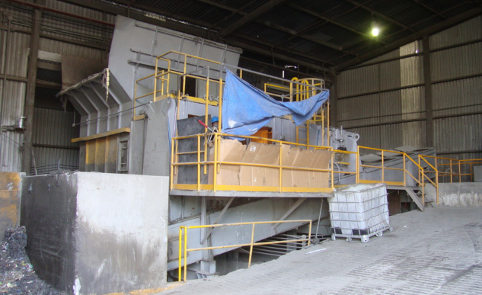
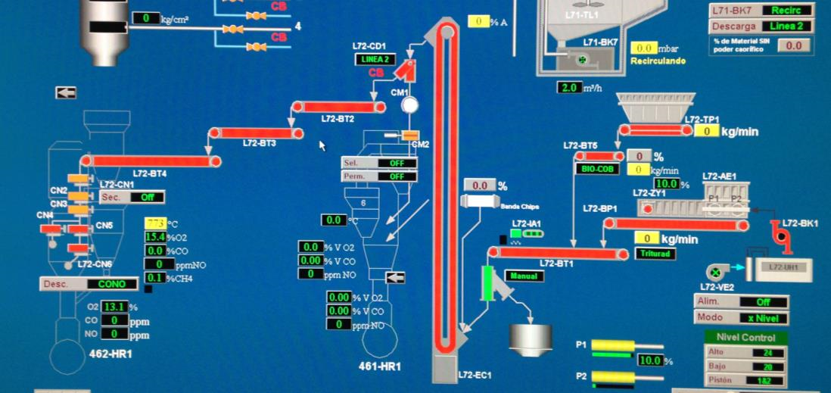

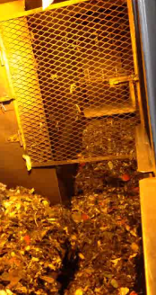
Shredded solids feed system (Case1)
push-floor hopper
belt (VSD) with weighing idler
stripping
wheel

Slide 5
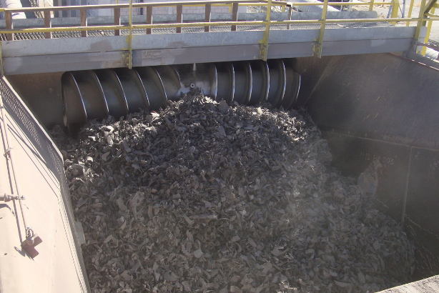
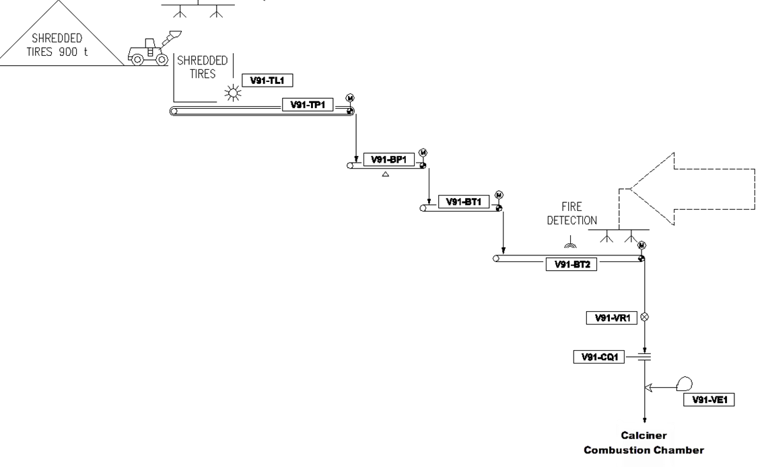
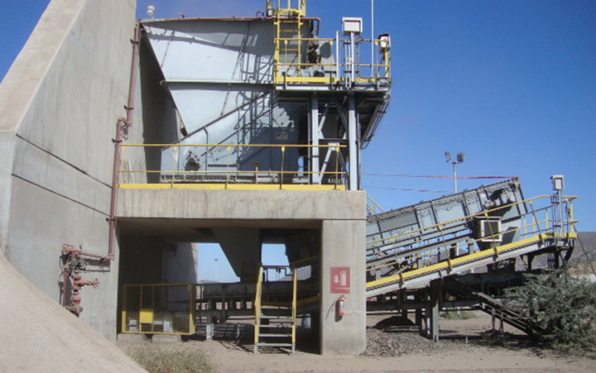
Tyre chip feeding (Case2)
Apron feeder with stripping wheel
Apron feeder (VSD)
belt weigh feeder (VSD)

Slide 6
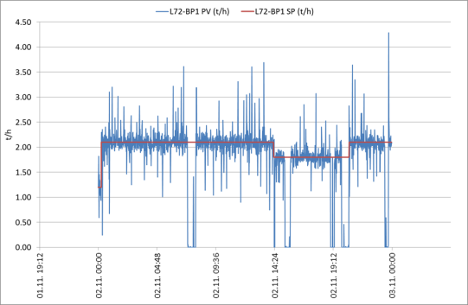
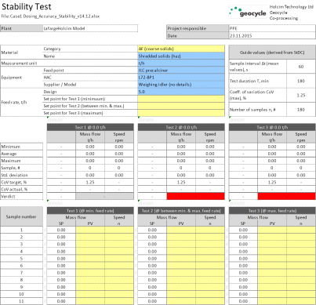
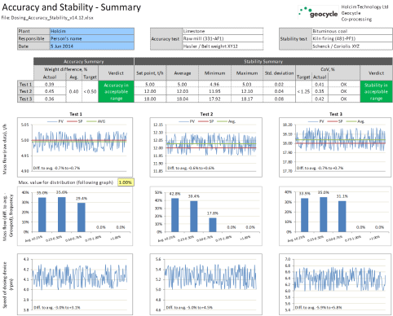
Given Information per case (Example)
Dataset file incl. graph & flowsheet
Dosing Accuracy & Stability Tool

Slide 7
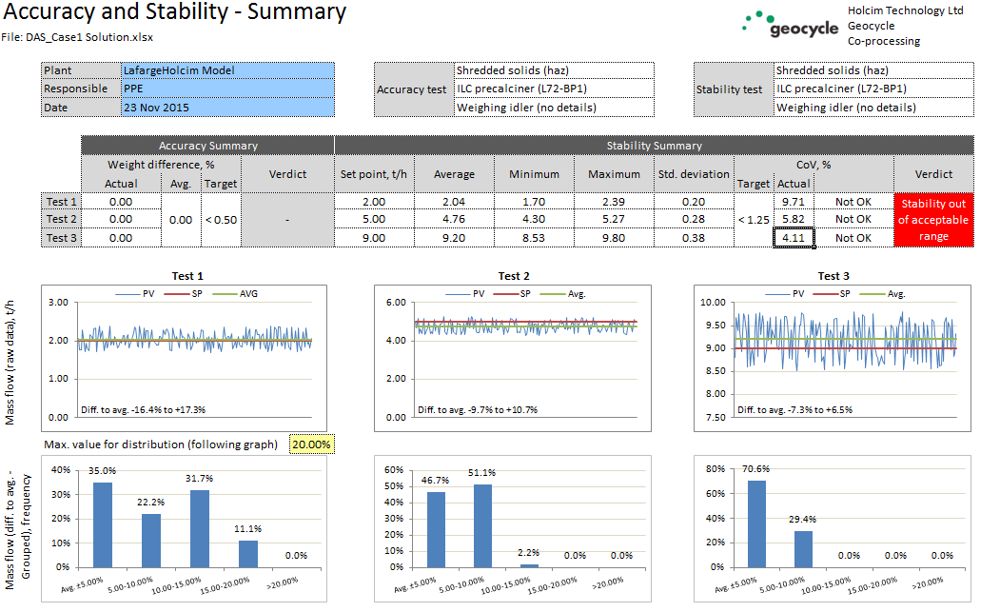
Case1: Solution
Poor dosing stability => out of the acceptable range for all the 3 tests
“Average” closest to SP for Test1, BUT CoV is the highest (9.7)
CoV > 1.25 (4.1 – 9.7)

Slide 8
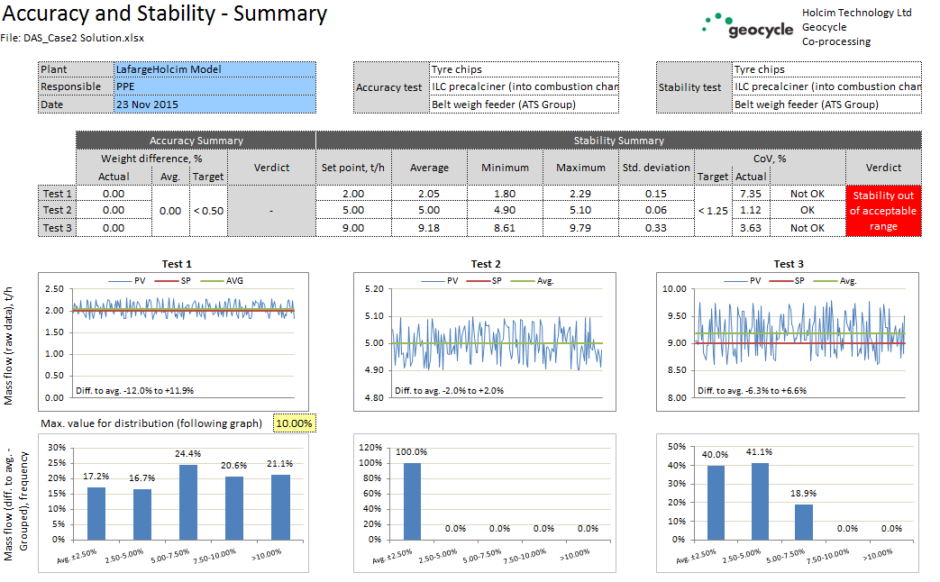
Case2: Solution
Speed is also used (VSD of the apron conveyor feeding the weighing belt)
Accepted dosing stability for Test2 (CoV = 1.12; SD = 0.06); Observe also the Gauss bell for “Speed” => Often in real cases we have difficulties to keep good stability for small or high feed rates
For Test1, Average is closer to SP than Test3, but CoV is the highest (7.35 vs 3.6)

Slide 9
Final messages
Define the SP for the tests according to the needs (Min, Max, In-between)
Expect higher fluctuations for small or high feed rates
Change in material density affects the stability
Check regularly also the Accuracy => Dosing calibration planning!
DAS allows to assess performance of a weighing device in a standardized way (no standard existed in past)
You can fix a problem only if you know where the problem is => see the tips in the Help sheet ... what to do if accuracy/stability is not acceptable)
DAS has been designed according to agreement with standard suppliers e.g. Schenck, Pfister, Hasler, etc. who signed off accuracy/stability objectives
In many cases, we may think feeder is operating OK, however DAS can reveal improvements that can be made to make the process even more stable. If a feeder fails the test, we can press suppliers to improve the performance or we can revise our plant maintenance and calibration procedures
➔ USE THE TOOL !!!

